Slide 1


ON-DEVICE
VISUAL QUESTION ANSWERING (VQA)
SYSTEM AIMED FOR THE VISUALLY IMAIRED
Graduation Project
Department of Computer and Automatic Control Engineering
17-07-2021

Slide 2
TODAY’S AGENDA
01
05
02
06
03
07
04
08
INTRODUCTION
MODEL ARCHITECTURE
Introduce the team and the project idea
Introducing the intelligent part of our project
MOTIVATION
DATASET
Why we thought of this project?
Introducing the dataset used
PROBLEM
MOBILE APP
What are we trying to solve here?
Introducing how we we developed our mobile app and deployed the model
OUR SOLUTION
DEMO
What is our approach?
A DEMO shows what we were working on

Slide 3
01
INTRODUCTION

Slide 4
MEET OUR TEAM
Ashraqat Hesham
Mostafa Nafie
Mohamed Nasser
Nadine Fadlallah
Nada Adel

Slide 5
PROJECT IDEA
We aimed to develop a prototype of an assistive system that employs
“Visual Question Answering (VQA)”task that helps the individuals with vision impairment get more independent with their everyday activities

Slide 6
What is the “VQA” Problem?
VQA is multi-discipline Artificial Intelligence (AI) problem; it combines Computer Vision (CV), Natural Language Processing (NLP)
Given an image and a natural-language question about the image, the task is to understand both the image and question and respond to the user with an accurate natural-language answer

Slide 7
02
MOTIVATION

Slide 8
MOTIVATION
Globally, 49.1 million were blind and
33.6 million had severe visual impairment in 2020
An individual with vision impairment is more likely to experience limitations in their independence, mobility, and productivity and lower rates of workforce participation
Notes:
Vision impairment severely impacts the quality of life among adult populations. An individual with vision impairment is more likely to experience limitations in their independence, mobility, and productivity which then contribute to lower rates of workforce participation and higher rates of depression and anxiety

Slide 9
03
PROBLEM

Slide 10

PROBLEM
We need to ensure that our system is:
Notes:
HEEEYY???

Slide 11
03
OUR SOLUTION

Slide 12
SOLUTION
Develop an android app that queries an image from the user’s mobile camera and a question expressed in natural language from the mobile’s microphone
2. Build an AI model the understands both the image and question and respond to the user with an accurate natural-language answer
3. Deploy the entire model locally on the user’s device
Notes:
without the need to talk to a remote server over the internet.

Slide 13
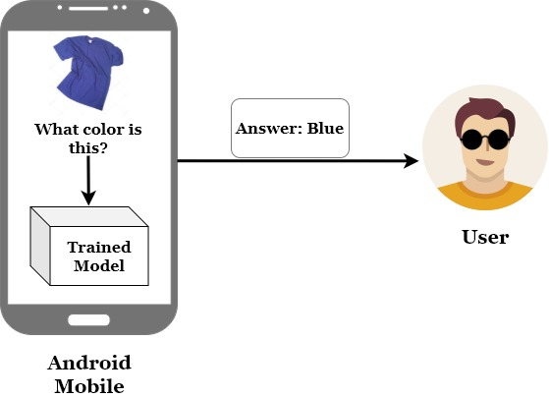
SOLUTION

Slide 14
05
MODEL Architecture
Notes:
HI?
Sorry I have just noticed
HELLOO

Slide 15
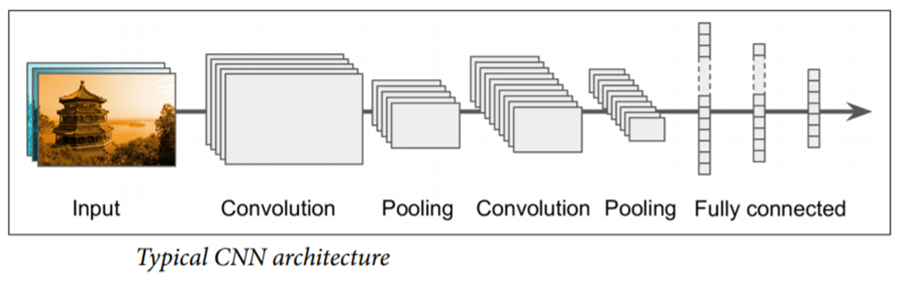
CNN OVERVIEW
Why convolution
Layers : conv, pool, FC
Transfer Learning

Slide 16
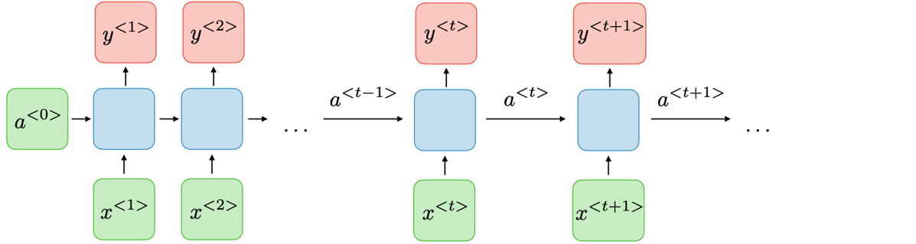
RNN OVERVIEW
Processing sequence data
LSTM
Word Embeddings

Slide 17
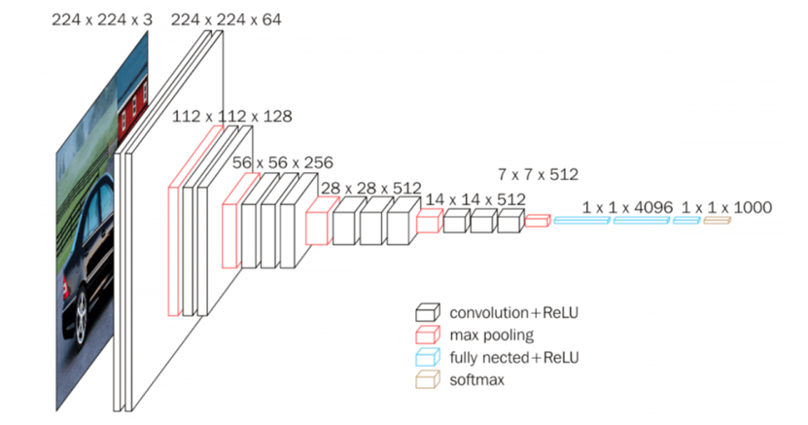
OUR MODEL
Image Encoder / Image model / Feature Extraction
5 blocks of (convpool), 2 FC layers.
Conv: 3*3 filters, s=1, same convolution padding-----Pool: Max, 2*2 window, s=2
Number of filters double after every pool layer
Trained on ImageNet, outputs 1000 classes

Slide 18
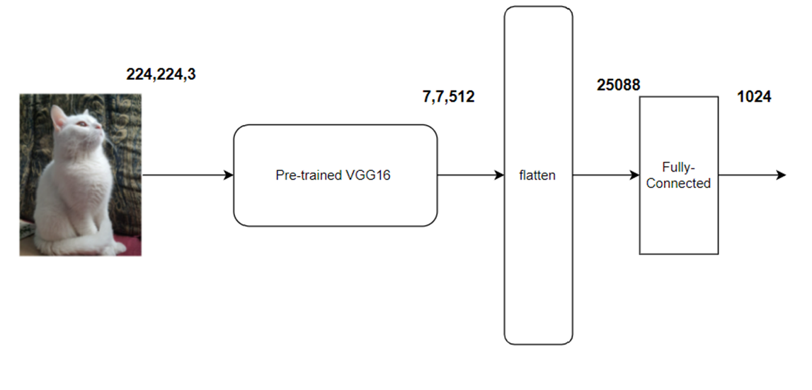

Slide 19
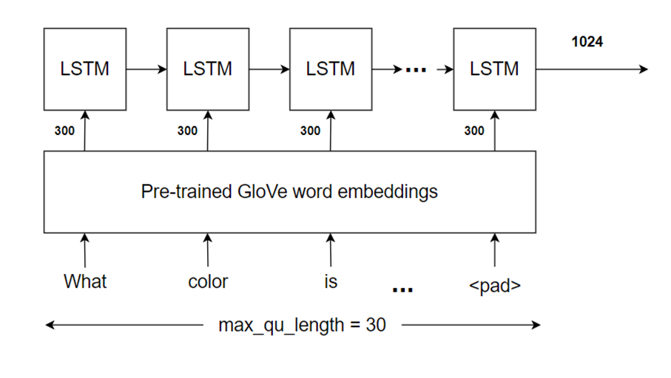
QUESTION ENCODER

Slide 20
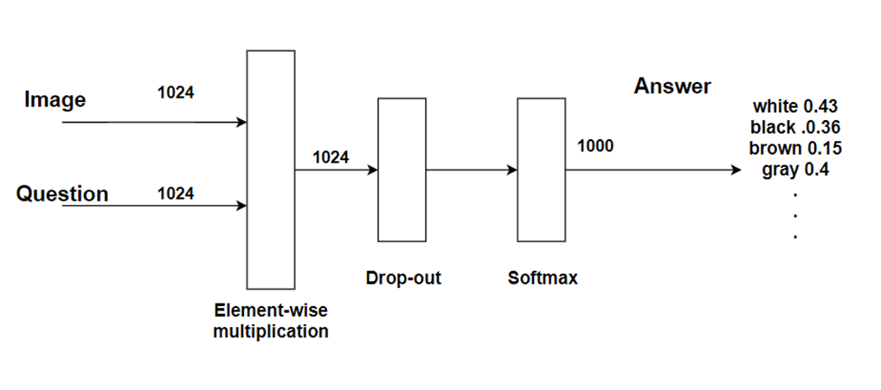
ANSWER PREDICTOR

Slide 21
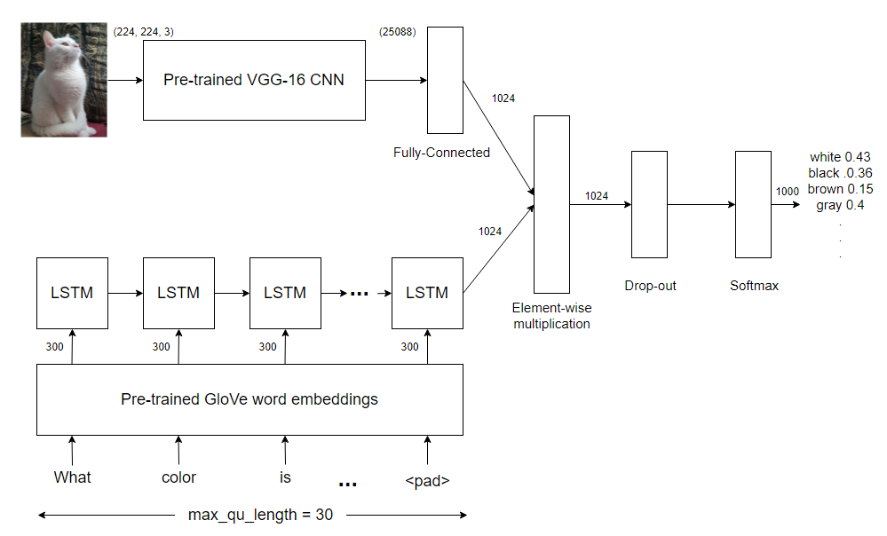

Slide 22
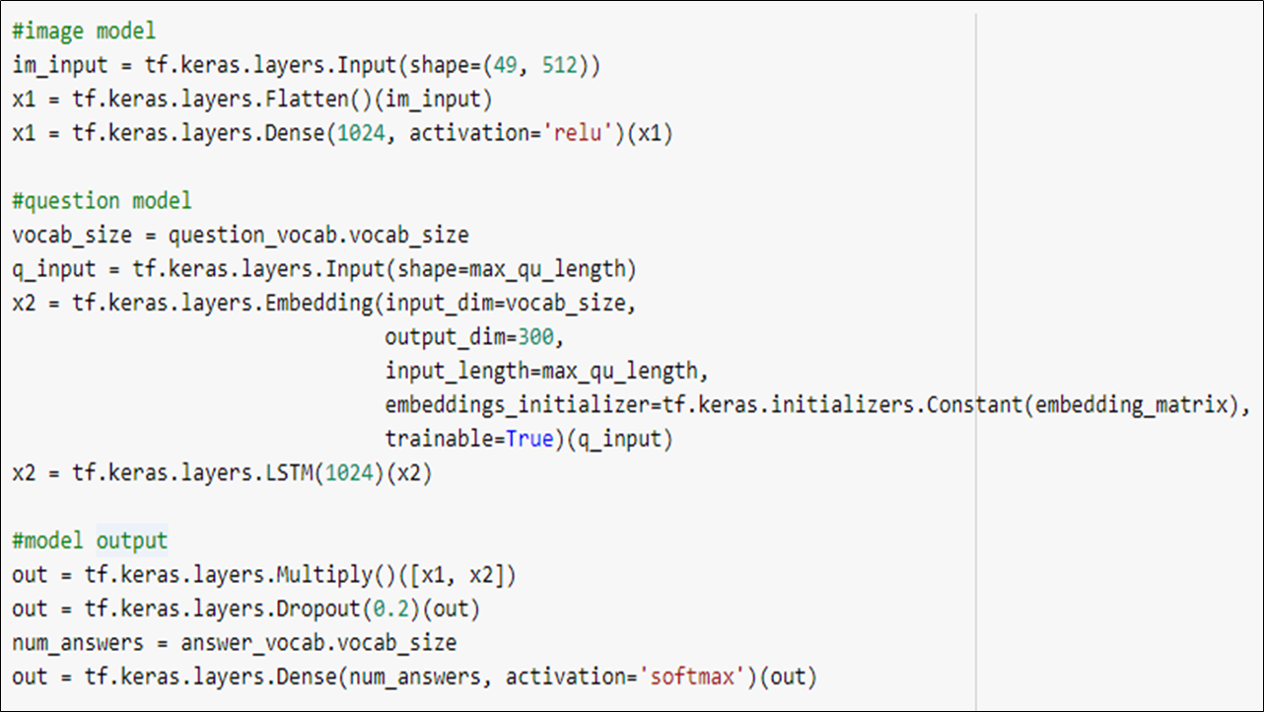

Slide 23
06
DATASET

Slide 24
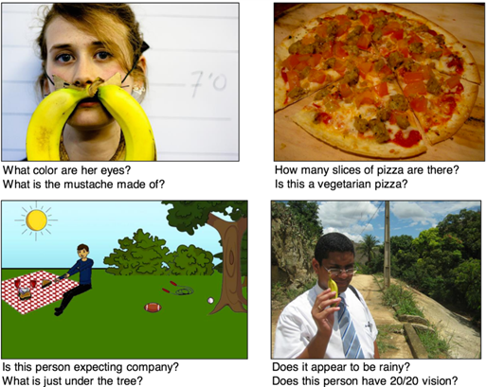
VQA DATASET
VQA V2 dataset for MS-COCO images dataset
QUESTIONS, ANSWERS, and IMAGES

Slide 25
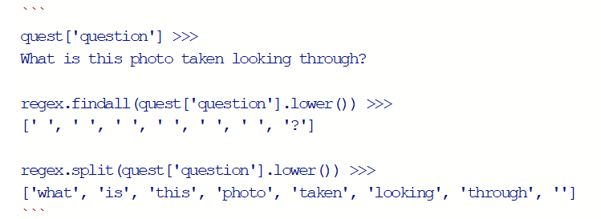
QUESTIONS
TRAIN: 443,757
VALIDATION: 214,354
TEST: 447,793

Slide 26
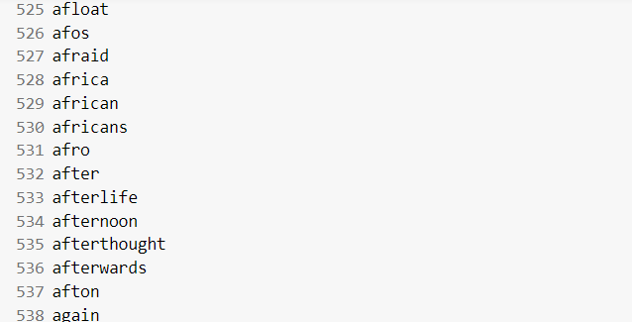
QUESTIONS VOCABULARY

Slide 27
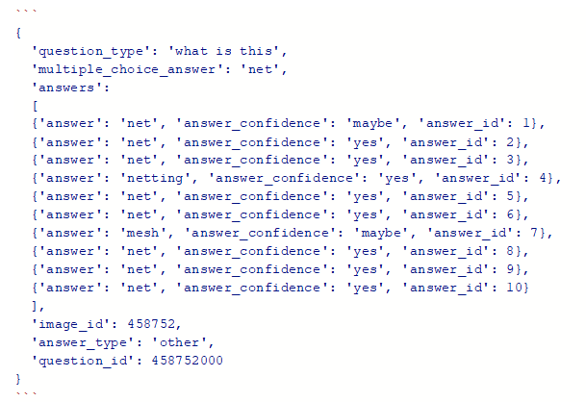
ANSWERS
TRAIN: 4,437,570
VALIDATION: 2,143,540

Slide 28
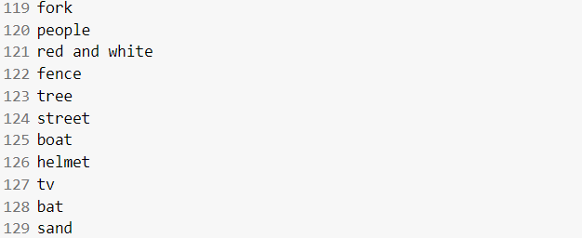
ANSWERS VOCABULARY
Our answers vocabulary consists of 26,480 unique answers.

Slide 29
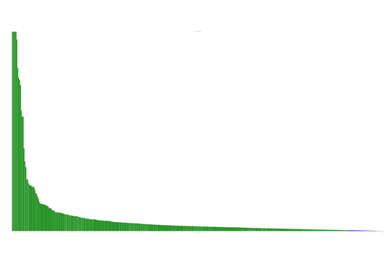
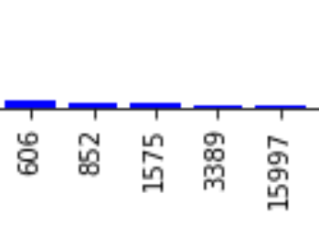
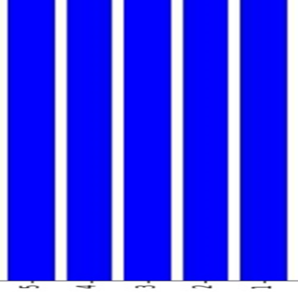
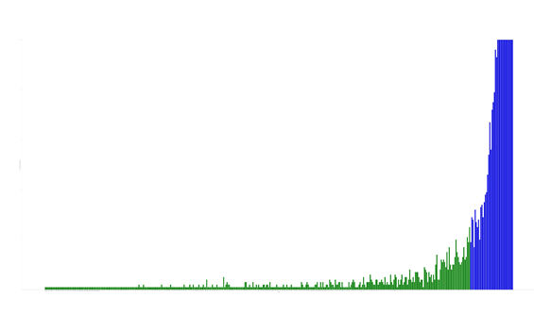

Slide 30
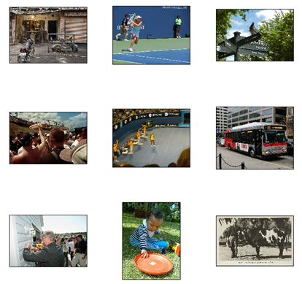
IMAGES
TRAIN: 82,783
VALIDATION: 40,504
TEST: 81,434

Slide 31
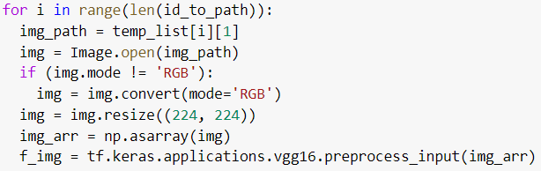
IMAGE PREPROCESSING
PRE-TRAINED VGG_16
RESIZE IMAGE TO BE IN SHAPE OF (224, 224, 3)
PREPROCESS THE IMAGE USING “vgg16.preprocess_input()”
CENTER THE VALUES ABOUT ZERO
BGR instead of RGB

Slide 32
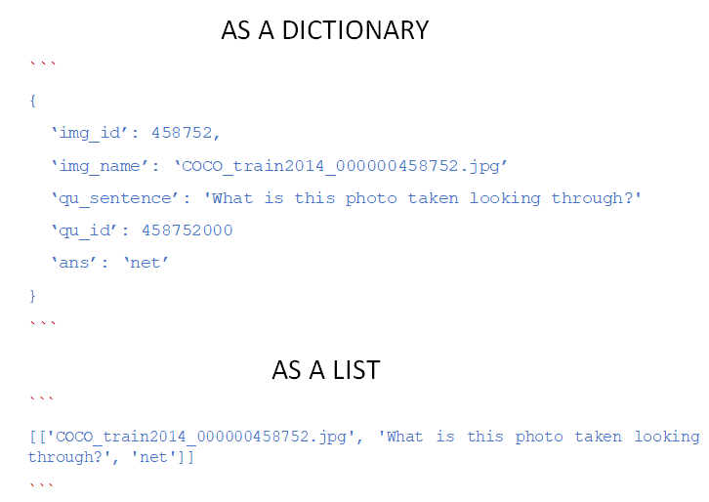
EXTRACTING INFORMATION
train.npy
val.npy
test.npy
test-dev.npy

Slide 33
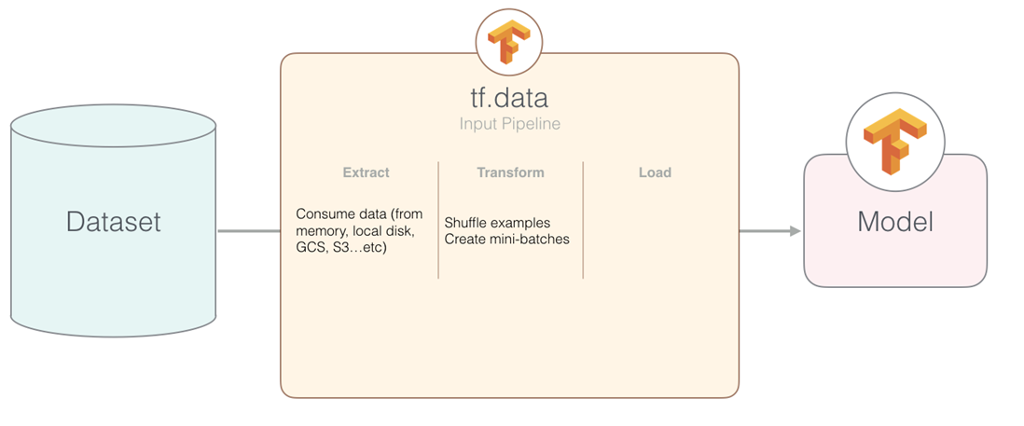
BUILDING OUR DATASET INPUT PIPELINE

Slide 34
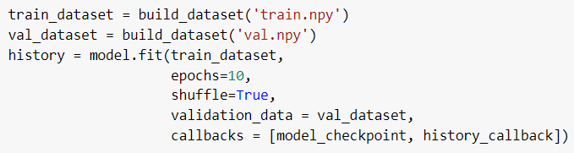
FEEDING THE DATA INTO OUR MODEL
BUILD TRAIN DATASET
BUILD VAL DATASET

Slide 35
07
MOBILE APP

Slide 36

Recent breakthroughs in deep learning research have enabled numerous AI applications
Devices, machines and things are becoming more and more intelligent
Greater benefit will come when the artificial intelligence technologies becomes ubiquitous in mobile applications

Slide 37

The Old Paradigm of AI Applications

Slide 38
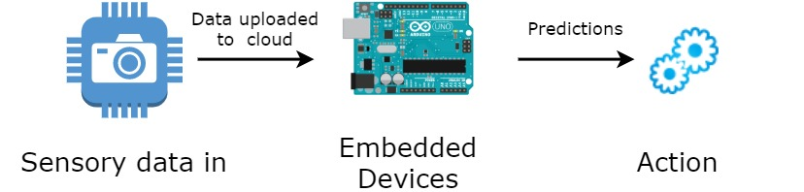
What’s On-Device AI?
TinyML/ On-Device AI is a cutting-edge field that brings the transformative power of machine learning (ML) to the performance- and power-constrained domain of tiny devices and embedded systems.

Slide 39
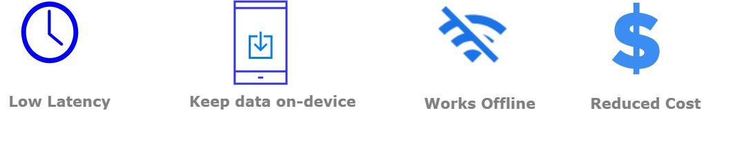
Why TinyML?

Slide 40
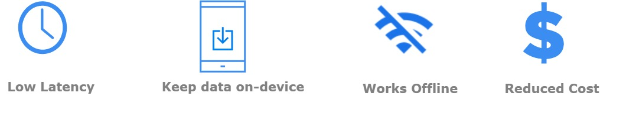
Why TinyML?

Slide 41


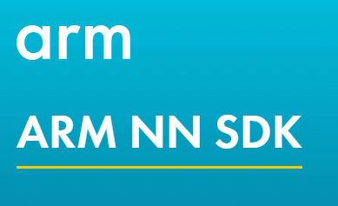
TinyML Platforms

Slide 42
TinyML Applications?

Slide 43
TensorFlow Lite
•Definition
•Key features:
•Optimized for on-device machine learning:
•Latency
•Privacy
•Connectivity
•Light-weight
•Power consumption
•Diverse language support ( Python, Java, C++)
•High performance, with hardware acceleration and model optimization

Slide 44
TensorFlow Lite
TFLite consists of two core components:
converter and interpreter
TensorFlow Lite Support

Slide 45
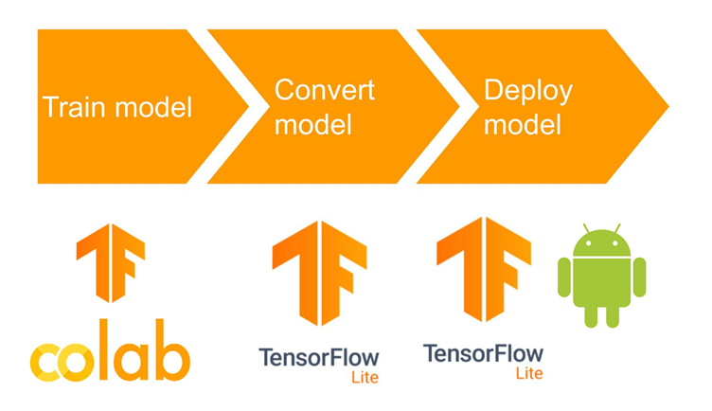
MODEL DEPLOYMENT

Slide 46
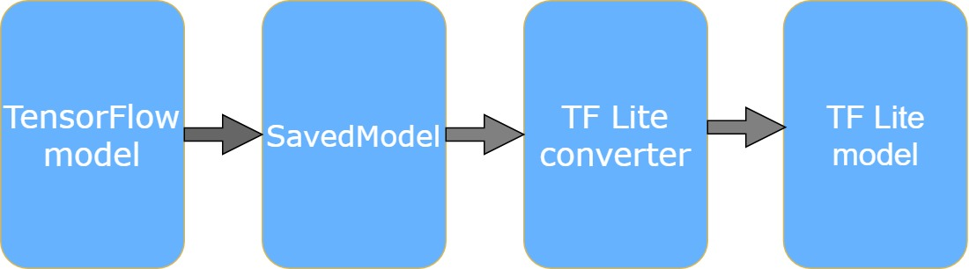
MODEL DEPLOYMENT
1) Generate TensorFlow Lite model:
•TFLite format
•Conversion steps

Slide 47
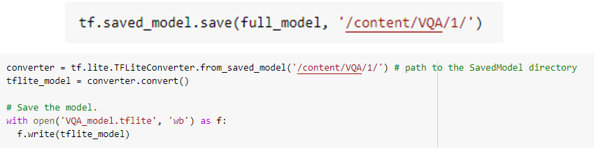
MODEL DEPLOYMENT
Conversion code:

Slide 48
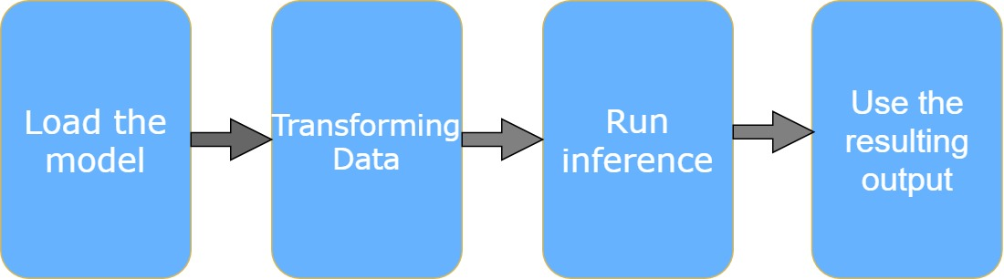
MODEL DEPLOYMENT
2) Run inference on the Android application:

Slide 49
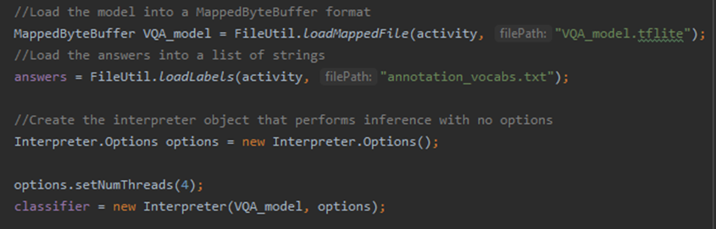
MODEL DEPLOYMENT
Loading the model:
Load the model from disk into the TFLite interpreter

Slide 50
MODEL DEPLOYMENT
Transforming data:
Create input/output containers.
Read the input data.
Pre-process the inputs.

Slide 51
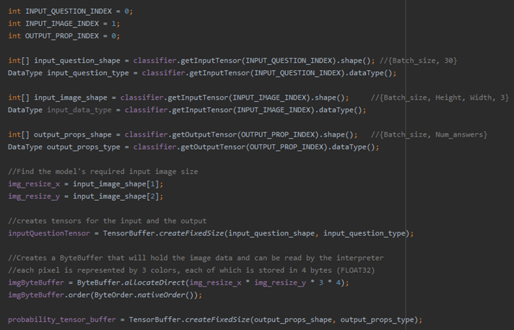
MODEL DEPLOYMENT
Creating input/output containers:

Slide 52
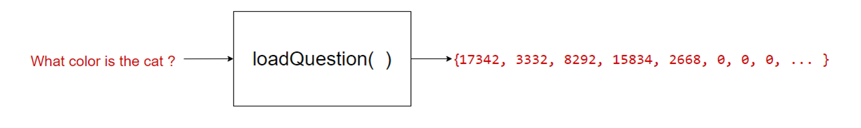
MODEL DEPLOYMENT
Question Preprocessing:

Slide 53
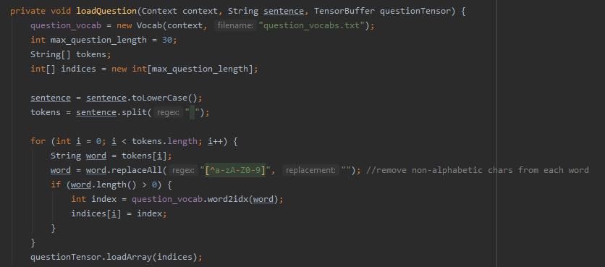
MODEL DEPLOYMENT
Question Preprocessing Code:

Slide 54
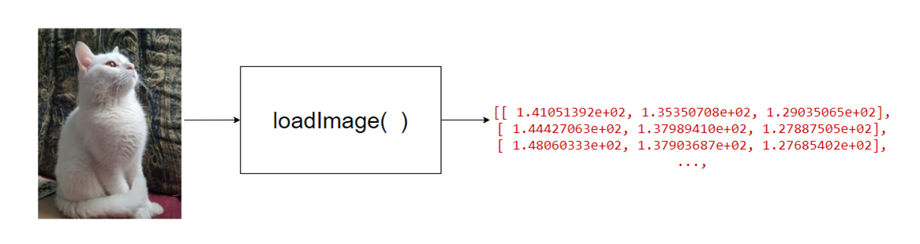
MODEL DEPLOYMENT
Image Preprocessing:

Slide 55
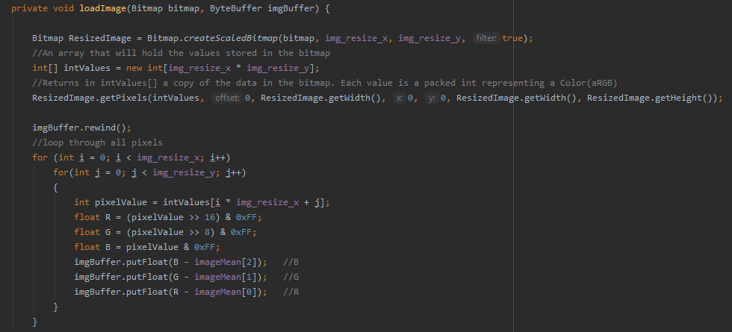
MODEL DEPLOYMENT
Image Preprocessing Code:

Slide 56
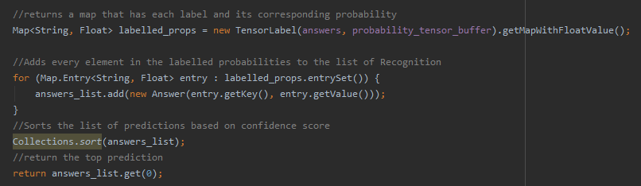
MODEL DEPLOYMENT
4) Use the output:
Map each answer to its corresponding prediction score.
Give the user the answer with the highest probability.

Slide 57
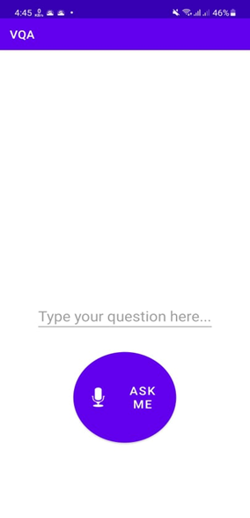
DEMO
User interface:
A simple interface with one button
It opens the user camera to take a picture
Uses the mobile’s microphone to take the question
Outputs the result on screen and pronounce it

Slide 58
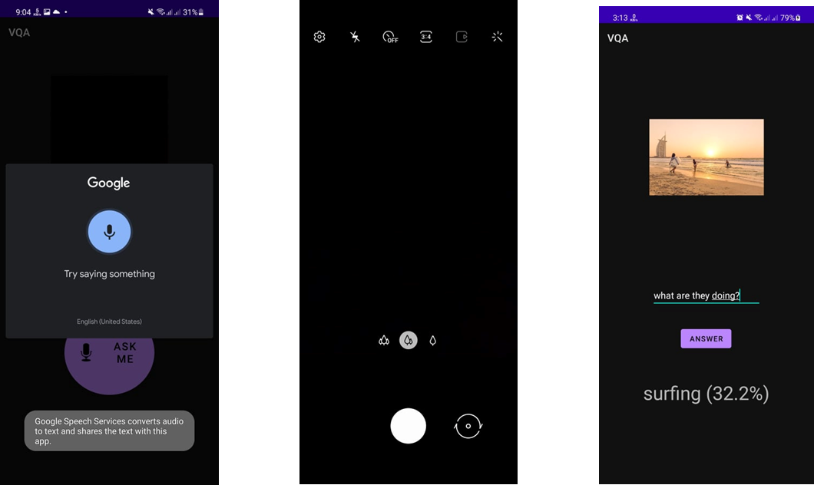
DEMO

Slide 59
Challenges

Slide 60
Future Work

Slide 61
WE
THANK YOU

